Slide 1
Antiarrhythmics

Slide 2
Cardiac Arrhythmias
Cardiac arrhythmias are the most common cause of death in patients with a myocardial infarction or terminal heart failure.
Normal sinus rhythm is dependent on generation of an impulse in the normal sinoatrial (SA) node pacemaker and its conduction through the atrial muscle, through the atrioventricular (AV) node, through the Purkinje conduction system, to the ventricular muscle

Slide 3
Action Potential of Cardiac Myocyte
Normal pacemaking and conduction require normal action potentials (dependent on sodium, calcium, and potassium channel activity) under appropriate autonomic control.
Cardiac myocytes are electrically excitable and have a spontaneous, intrinsic rhythm generated by specialized “pacemaker” cells located in the sinoatrial (SA) and atrioventricular (AV) nodes.
Cardiac myocytes also have an unusually long action potential, which can be divided into five phases (0 to 4)
Phase 0: Fast upstroke, Na channels open resulting in a fast inward current of Na.

Slide 4
Action Potential of Cardiac Myocyte

Slide 5
Phase 1: Partial repolarization, due to inactivation of Na channels. While K channels rapidly open and close causing a transient outward current of K.
Phase 2: Voltage-gated Ca channels open resulting in a slow inward current of Ca that balances the slow outward leak of K.
Phase 3: Ca channels close. K channels open causing outward current of K that lead to mb repolarization.
Phase 4: a net gain of Na & loss of K is corrected by Na/K ATPase. The spontaneous depolarization automatically brings the cell to the threshold of next action potential.

Slide 7
Causes of arrhythmias
1. Abnormal automaticity: SA node shows a faster rate of discharge, and thus, it normally sets contraction for the myocardium. If cardiac sites other than the SA node show enhanced automaticity, they may generate competing stimuli, and arrhythmias may arise.
2. Abnormalities in impulse conduction: A phenomenon called reentry can occur if a unidirectional block caused by myocardial injury or a prolonged refractory period results in an abnormal conduction pathway. Reentry is the most common cause of arrhythmias, and it can occur at any level of the cardiac conduction system.

Slide 8
Common Types of Arrhythmias
A few of the clinically important arrhythmias are atrial flutter, atrial fibrillation (AF), atrioventricular nodal reentry (a common type of supraventricular tachycardia [SVT]), premature ventricular beats (PVBs), ventricular tachycardia (VT), and ventricular fibrillation (VF).
AF is the most common arrhythmia particularly common in older patients. It is often symptomatic and may contribute to worsening heart failure.

Slide 9
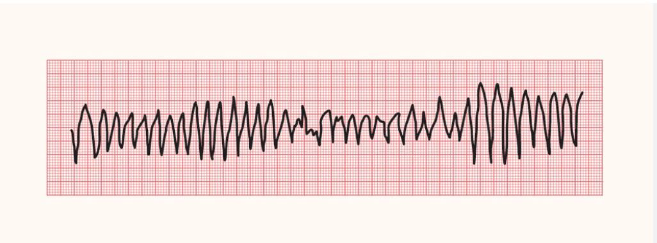
Torsades de pointes is a ventricular arrhythmia of great pharmacologic importance because it is often induced by antiarrhythmic and other drugs that change the shape of the action potential and prolong the QT interval. It has the ECG morphology of a polymorphic ventricular tachycardia.
Other causes: macrolide antibiotics, antipsychotics, hypokalemia, ischemia, and genetic.

Slide 11
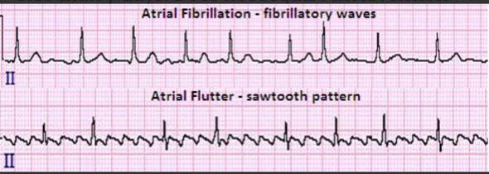
Therapeutic indications for Common Arrhythmias
Atrial fibrillation (AF): irregular tachycardia due to multiple atrial ectopics. It may cause stroke due to blood stagnation in fibrillated atria.
Common drugs: Metoprolol (class 2), Amiodarone (class 3), Diltiazem (class 4), Anticoagulant (warfarin).
Alternative drugs: Digoxin

Slide 12
Supraventricular tachycardia (SVT):

Slide 13
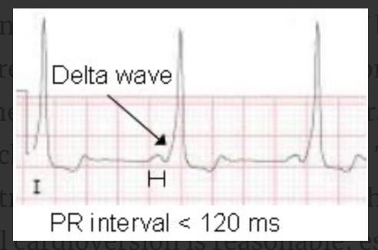
Wolff-Parkinson-White (WPW) Syndrome
Characterized by the presence of an “accessory pathway”. This connects the electrical system of the atria directly to the ventricles, allowing conduction to avoid passing through the AV node.
The combination of WPW and atrial fibrillation can potentially be fatal, especially if AV blocking agents are given (“ABCD” for adenosine or amiodarone, beta-blockers, calcium channel blockers and digoxin).
The medical treatment is procainamide but electrical cardioversion is reasonable, especially with hemodynamic instability.
Catheter ablation is the treatment of choice.

Slide 14
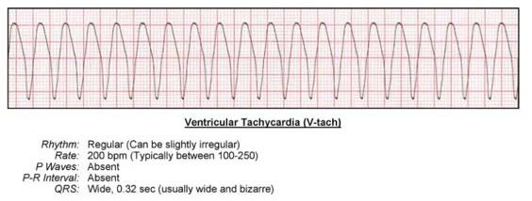
Ventricular Tachycardia (VT)
Common cause of death in MI & HF. COP is impaired.
Implantable cardioverter defibrillator is commonly used.
Acute VT: Amiodarone (Cass 3), Lidocaine (Class 1, alternative)
Ventricular fibrillation (not responding to electrical defibrillation): Adrenalin (Epinephrine) & Amiodarone, Lidocaine (alternative)

